Slide 1
The Hallmarks Of Cancer In search of the underlying principles common to all cancers
Douglas Hanahan, Robert A. Weinberg
Dvir Netanely
Group Meeting – Ron Shamir’s Lab, TAU
September 2012

Slide 2
Reviewed Papers
The Hallmarks of Cancer
Hanahan D, Weinberg RA.
Cell. 2000 Jan 7;100(1):57-70. Review.
http://www.sciencedirect.com/science/article/pii/S0092867400816839
Hallmarks of cancer: the next generation
Hanahan D, Weinberg RA.
Cell. 2011 Mar 4;144(5):646-74. Review.
http://www.cell.com/abstract/S0092-8674(11)00127-9
"Hallmarks of cancer: progress and perspectives”
Cell Webinar, March 2012

Slide 3
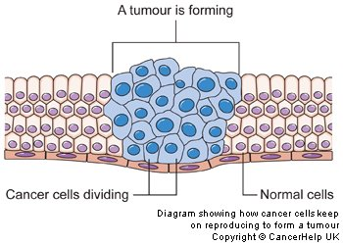
Introduction to Cancer
Cancer is a group of diseases in which cells divide and grow uncontrollably, forming malignant tumors, and invade nearby parts of the body.

Slide 4
Normal versus Tumorous cells
Normal cells…
Reproduce under tight control and make identical copies of themselves.
Stop reproducing at the right time
Stick together in the right place
Self destruct if they are damaged
Tumorous cells…
Don't stop reproducing (Chronic proliferation)
Don’t obey signals from other cells
Don't stick together (Become metastatic)
Don’t specialize (differentiate), but stay immature
Notes:
Normal cells have a very tight control over their proliferation – they stop dividing at the right time, stick together in one place and conduct apoptosis if damages
In contrast, tumorous cells continue to divide endlessly, ignore signals, don’t stick together and remain in an undifferentiated state

Slide 5
Cancer Abundance
In 2007, cancer caused about 13% of all human deaths worldwide (7.9 million).
Deaths from cancer worldwide are projected to continue rising, with an estimated 13.1 million deaths in 2030.
Cancer is the second most common cause of death in the US, accounting for nearly 1 of every 4 deaths
“Cancer Facts & Figures 2012”, American Cancer Society

Slide 6
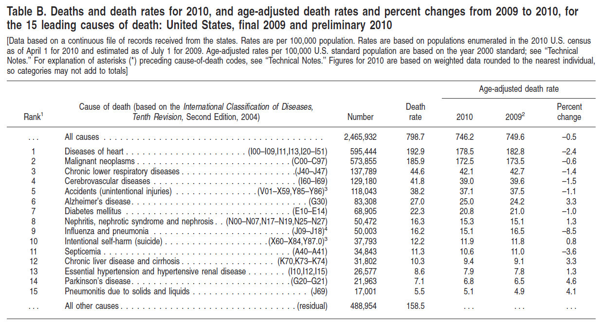
Leading causes of death in the US, 2010
“Deaths: Preliminary Data for 2010”, US CDC

Slide 7
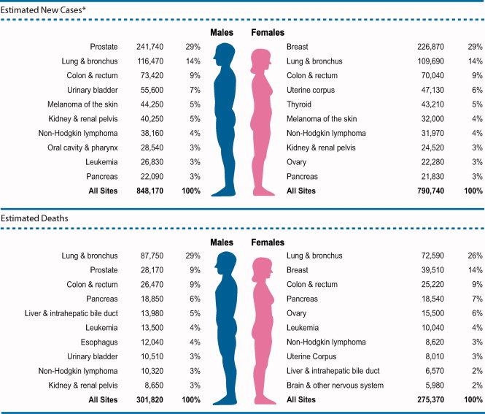
Cancer Types
“Cancer Facts & Figures 2012”, American Cancer Society
There are more than 200 different types of cancer.
Cancer can develop from almost any type of cell in the body. So there is usually more than one type of cancer that can develop in any one part of the body.

Slide 8
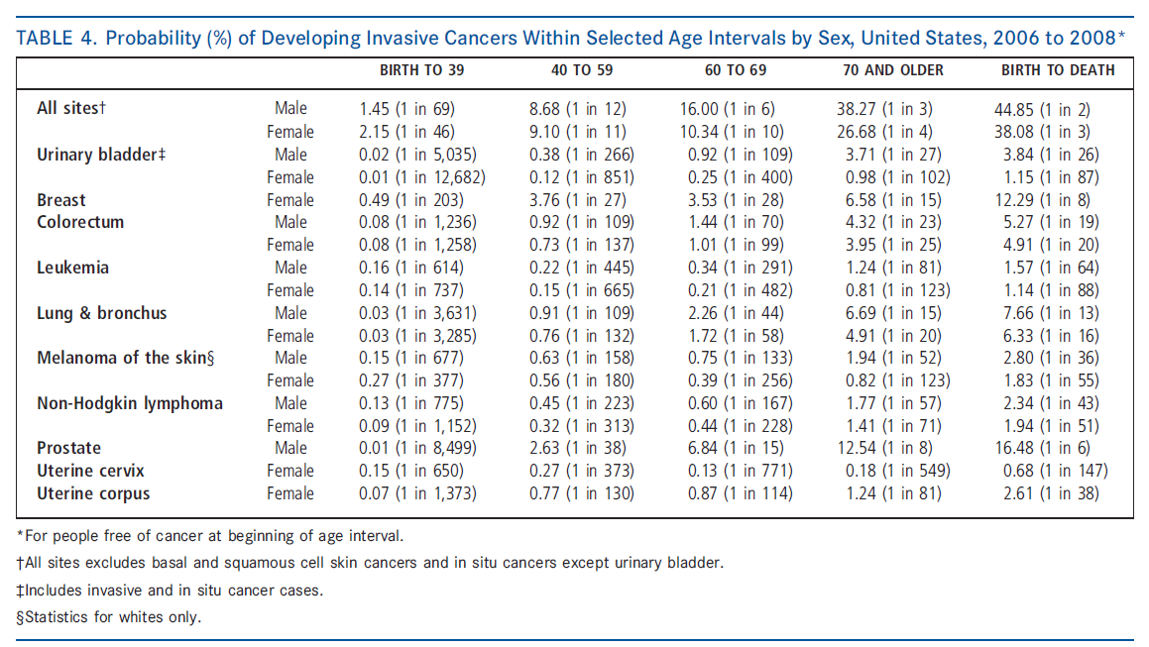
Cancer Abundance
“Cancer Facts & Figures 2012”, American Cancer Society

Slide 9
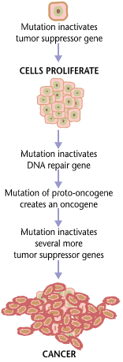
Tumorigenesis is a multi-step process
Tumorigenesis is a multi-step process by which normal cells are transformed into cancer cells by acquiring genetic changes.
It is characterized by a progression of changes on cellular and genetic level that ultimately reprogram a cell to undergo uncontrolled cell division and a malignant mass (neoplasm) is formed.
Three to six genetic changes are usually required for a normal cell to transform into a cancer cell.

Slide 10
Is cancer a heritable disease?
Cancer is a genetic disease, but the majority of mutations that lead to cancer are somatic
Mutations, Chromosomal aberrations and other genetic defects may alter genes required to promote cancer.
The affected genes are divided into two broad categories:
Oncogenes are genes which promote cell growth and reproduction.
Tumor suppressor genes are genes which inhibit cell division and survival.

Slide 11
What causes the mutations that lead to cancer?
Viruses: HPV --> cervical cancer
Bacteria: H. pylori --> gastric cancer
Chemicals --> B[a]P --> lung cancer
UV and ionizing radiation --> skin cancer
“Cancer Facts & Figures 2012”, American Cancer Society

Slide 12
The Hallmarks of Cancer
The Six Acquired Hallmarks

Slide 13
The Hallmarks of Cancer
The hallmarks of cancer provide a logical framework for understanding the remarkable diversity of neoplastic diseases .
As normal cells evolve progressively to a neoplastic state, they acquire these hallmark capabilities.

Slide 14
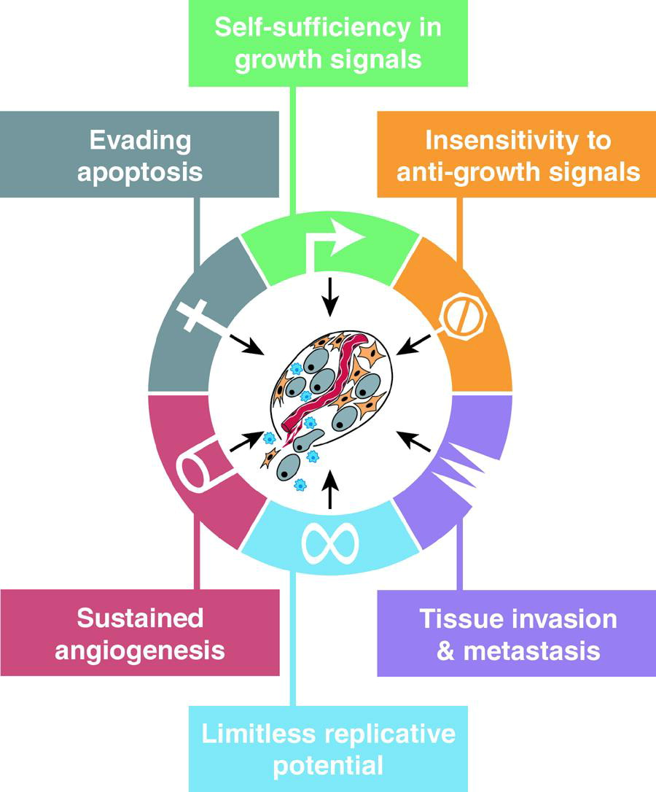

Slide 15
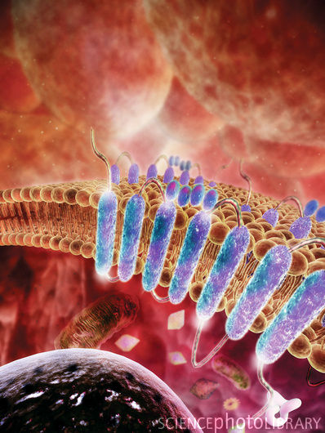
Hallmark 1: Self-Sufficiency in Growth Signals
Normal cells require growth signals (GS) before they start dividing (by moving from a quiescent state into an active proliferative state).
These signals are transmitted into the cell by transmembrane receptors that bind distinctive classes of signaling molecules.
Tumor cells generate their own growth signals, thereby reducing their dependence on stimulation from their normal tissue microenvironment.
This liberation from dependence on external signals disrupts a critically important homeostatic mechanism that normally operates to ensure a proper behavior of the various cell types within a tissue.

Slide 16
Hallmark 1: Self-Sufficiency in Growth Signals
Three common strategies for achieving growth signal autonomy:
Alteration of extracellular growth signals
Many cancer cells acquire the ability to synthesize GFs to which they are responsive, creating a positive feedback signaling loop
Alternation of transcellular transducers of those signals
Receptor overexpression may enable the cancer cell to become hyperresponsive to ambient levels of GF that normally would not trigger proliferation
Alternation of intracellular circuits that translate those signals into action.
Alterations in components of the downstream cytoplasmic circuitry that receives and processes the signals emitted by GF receptors can release a flux of signals into cells, without ongoing stimulation by their normal upstream regulators

Slide 17
Hallmark 1: Self-Sufficiency in Growth Signals
Example:
The SOS-Ras-Raf-MAPK cascade plays a central role here.
In about 25% of human tumors, Ras proteins are present in structurally altered forms that enable them to trigger the down stream cascade in the absence of external growth signals.
50% of colon cancer tumors bear mutant Ras oncogenes.

Slide 18
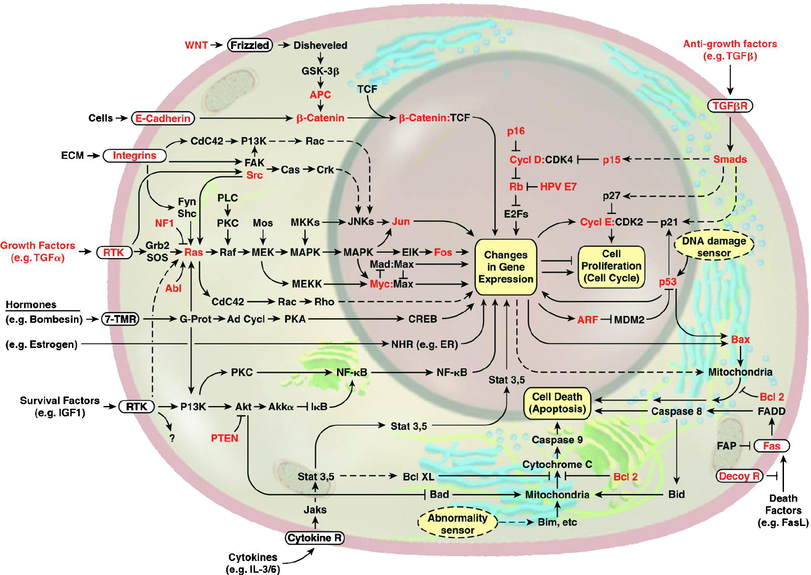
Hallmark 1: Self-Sufficiency in Growth Signals

Slide 19
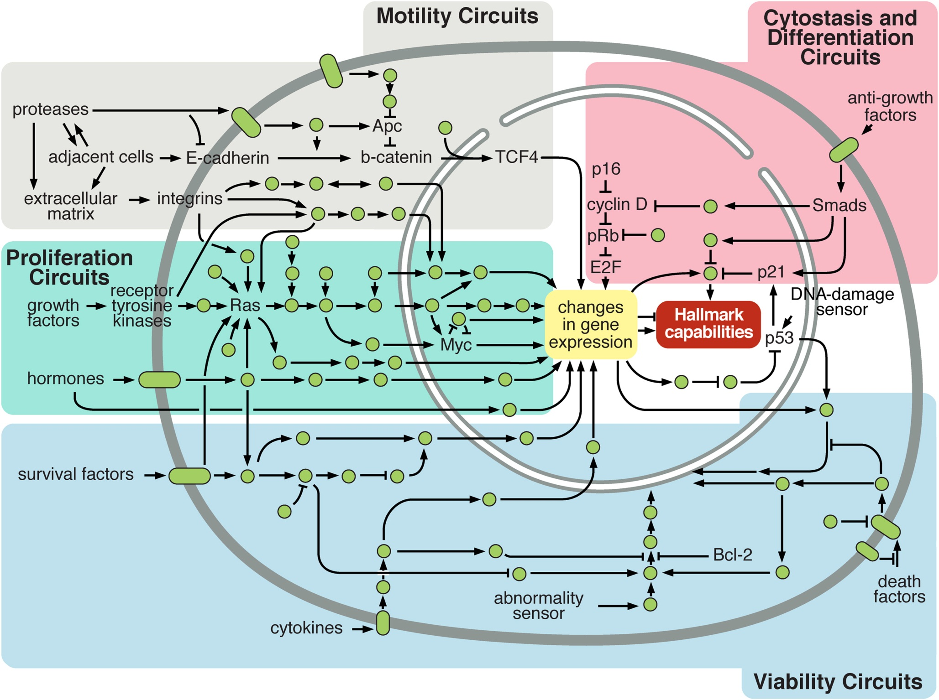
Hallmark 1: Self-Sufficiency in Growth Signals
Intracellular Signaling Networks Regulate the Operations of the Cancer Cell

Slide 20
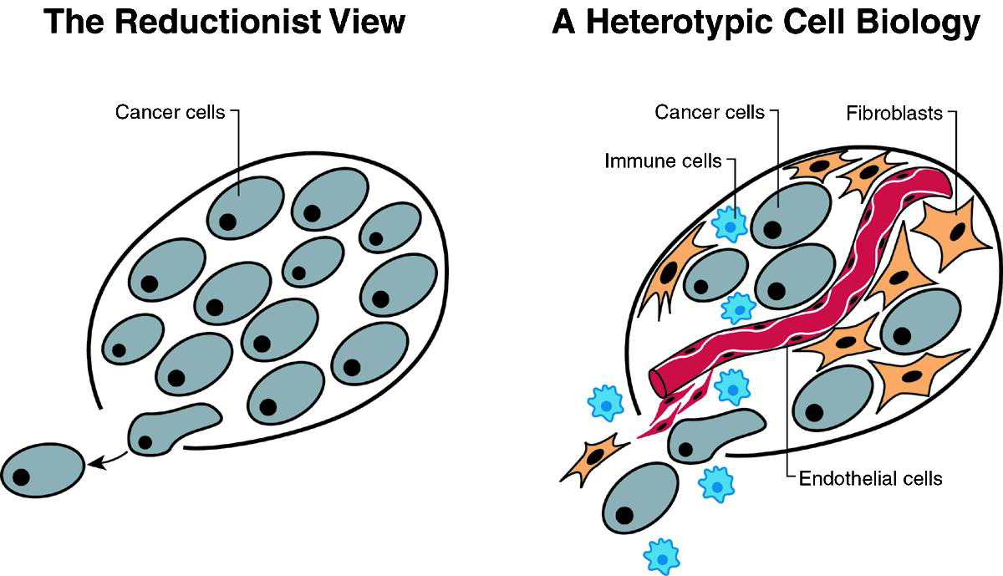
Hallmark 1: Self-Sufficiency in Growth Signals
Tumor cells may also acquire the ability to recruit their normal neighbors by inducing them to release abundant fluxes of growth-stimulating signals.
Tumor co-evolution
Gene expression studies
Mapping interactions between different cell types within the tumor

Slide 21
The Cell-Cycle
Normal human cells go through a cycle which is highly regulated and contains checkpoints to ensure cells are growing correctly.
If a cell is abnormal in some way and does not pass the “inspection” at a checkpoint within the cell cycle it is degraded. Cells which proceed through the cell cycle in an unregulated manner are considered cancers.
Fully differentiated cells are usually kept in the G0 state, as quiescent cells.

Slide 22
Cell Cycle Checkpoints

Slide 23
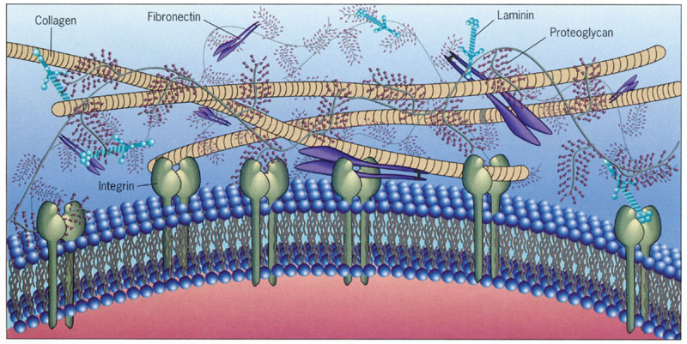
Hallmark 2: Insensitivity to Antigrowth Signals
Within a normal tissue, anti-growth signals maintain cells in a non-dividing state ensuring cellular quiescence and tissue homeostasis; (signals include soluble growth inhibitors, immobilized inhibitors embedded in ECM or on surfaces of nearby cells).
These growth-inhibitory signal are received by transmembrane cell surface receptors coupled to intracellular signaling circuits.

Slide 24
Hallmark 2: Insensitivity to Antigrowth Signals
Normal cells respond to antigrowth via components governing the transit of the cell through the G1 phase of its growth cycle.
Cells monitor their external environment during this period and, on the basis of sensed signals, decide whether to proliferate, to be quiescent, or to enter into a postmitotic state.
Cancer cells must evade negative regulation of cell proliferation; Retinoblastoma gene (RB) is a central tumor suppressor, in charge of blocking proliferation by halting cell cycle at G0.
The antigrowth circuit converging onto Rb and the cell division cycle is, one way or another, disrupted in a majority of human cancers, rendering cells insensitive to antigrowth factors.

Slide 25
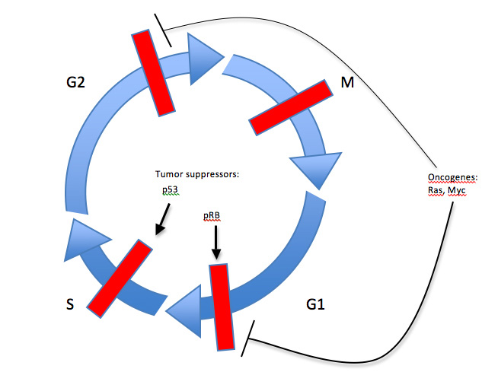
Cell cycle control by tumor suppressors and oncogenes
Checkpoints are depicted as thick red bars. The stages of the cell cycle (G1: Gap 1, S: DNA synthesis, G2: Gap 2, and M: mitosis) are indicated. Tumor suppressors act to maintain checkpoints (arrows) whereas oncogenes allow for checkpoints to be overcome (stop lines) (Adapted from Kopnin 2000).

Slide 26
Hallmark 3: Evading Cell Death (Apoptosis)
Apoptosis – programmed cell death, is a self-destruct mechanism, triggered in normal cells in response to either external death-inducing signals or signals of intracellular origin.
When initiated, the apoptosis effectors initiate a cascade of proteolysis caspases by which the cell is progressively disassembled and then consumed, both by its neighbors and by professional phagocytic cells.
The P53 tumor-suppressor gene is probably the most notable “internal abnormality sensor” that plays key role in tumor development.
P53’s protein, induces apoptosis in response to DNA damage, thus preventing the cell from accumulating additional mutations that might lead to uncontrolled growth.

Slide 27
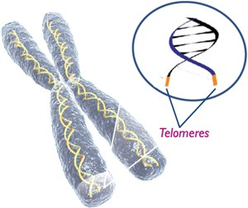
Hallmark 4: Limitless Replicative Potential
Most normal cells have a finite replicative potential (around 60-70 doublings).
Multiple lines of evidence links length of DNA telomeres (Chromosome ends, composed of multiple tandem hexanucleotide repeats and shorten progressively with each replication) with the replicative potential of the cell.
The immortalization of cells that proceed to form tumors has been attributed to their ability to maintain telomeric DNA at lengths sufficient to avoid triggering senescence or apoptosis, achieved most commonly by upregulating expression of telomerase (an enzyme that can prolong the telomeres).
Recently, additional proliferation related functions for telomerase were discovered, but their involvement in cancer is still undetermined.

Slide 28
Hallmark 5: Sustained Angiogenesis
Angiogenesis is the formation of new blood vessels from pre-existing vessels.
Like normal tissues, tumors require nutrients and oxygen as well as an ability to evacuate metabolic wastes and carbon dioxide, obligating virtually all cells in a tissue to reside within 100 μm of a capillary blood vessel.
In the adult, as part of physiologic processes such as wound healing, angiogenesis is turned on, but only transiently.
In contrast, during tumor progression, an “angiogenic switch” is almost always activated and remains on, causing normally quiescent vasculature to continually sprout new vessels that help sustain expanding neoplastic growths.
Angiogenesis: Tumorigenesis and the angiogenic switch, Nature Review 2003

Slide 29
Hallmark 5: Sustained Angiogenesis
Angiogenesis: Tumorigenesis and the angiogenic switch, Nature Review 2003

Slide 30
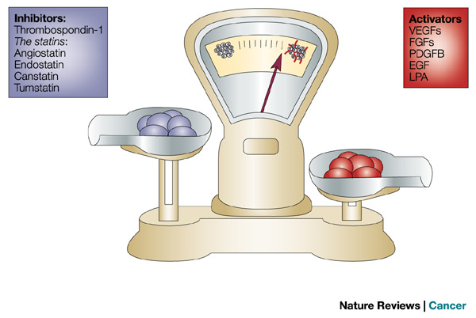
Hallmark 5: Sustained Angiogenesis
Tumors appear to activate the angiogenic switch by changing the balance of angiogenesis inducers and countervailing inhibitors. One common strategy for shifting the balance involves altered gene transcription.
Angiogenesis: Tumorigenesis and the angiogenic switch, Nature Review 2003

Slide 31
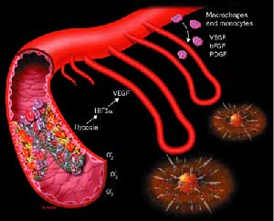
Hallmark 5: Sustained Angiogenesis
Tumor angiogenesis offers a uniquely attractive therapeutic target, indeed one that is shared in common by most and perhaps all types of human tumors.
The next decade will probably produce a catalog of the angiogenic regulatory molecules expressed by different types of tumors.
Will a single anti-angiogenic therapeutic will suffice to treat all tumor types, or whether an ensemble of such therapeutics will need to be developed, each responding to a distinct program of angiogenesis that has been developed by a specific class of human tumors ?
Angiogenesis: Tumorigenesis and the angiogenic switch, Nature Review 2003

Slide 32
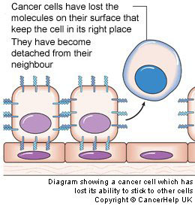
Hallmark 6: Tissue Invasion and Metastasis
At a certain point during the development of most types of human cancer, primary tumor masses spawn pioneer cells that move out, invade adjacent tissues, and travel to distant sites where they may succeed in founding new colonies.
These distant settlements of tumor cells - metastases - are the cause of 90% of human cancer deaths
The capability for invasion and metastasis enables cancer cells to colonize new terrain in the body where nutrients and space are not limiting.

Slide 33
Hallmark 6: Tissue Invasion and Metastasis
To acquire metastatic capabilities, cancer cells typically develop alterations in their shape as well as in their attachment to other cells and to the extracellular matrix (ECM).
Down-regulation of adhesion molecules like E-cadherin enables tumorous cells to detach from the primary tumor.
The ability to metastasize and the potential target locations may depend on additional gene expression alternations acquired by different cell sub-populations in the primary tumor.

Slide 34
Hallmark 6: Tissue Invasion and Metastasis
AACR Centennial Series: The Biology of Cancer Metastasis: Historical Perspective , Fidler et. Al 2010

Slide 35
Hallmark 6: Tissue Invasion and Metastasis
The multistep process of invasion and metastasis has been schematized as a sequence of discrete steps, often termed the invasion-metastasis cascade.
This depiction envisions a succession of cell-biologic changes, beginning with local invasion, then intravasation by cancer cells into nearby blood and lymphatic vessels, transit of cancer cells through the lymphatic and hematogenous systems, followed by escape of cancer cells from the lumina of such vessels into the parenchyma of distant tissues (extravasation), the formation of small nodules of cancer cells (micrometastases), and finally the growth of micrometastatic lesions into macroscopic tumors, this last step being termed “colonization.”
AACR Centennial Series: The Biology of Cancer Metastasis: Historical Perspective , Fidler et. Al 2010

Slide 36
Hallmark 6: Tissue Invasion and Metastasis
NEW: A developmental regulatory program, referred to as the “epithelial-mesenchymal transition” (EMT), has become prominently implicated as a means by which transformed epithelial cells can acquire the abilities to invade, to resist apoptosis, and to disseminate .
By co-opting a process involved in various steps of embryonic morphogenesis and wound healing, carcinoma cells can acquire multiple attributes that enable invasion and metastasis.
A set transcriptional factors orchestrate the EMT and related migratory processes during embryogenesis. These transcriptional regulators are expressed in various combinations in a number of malignant tumor types .

Slide 37
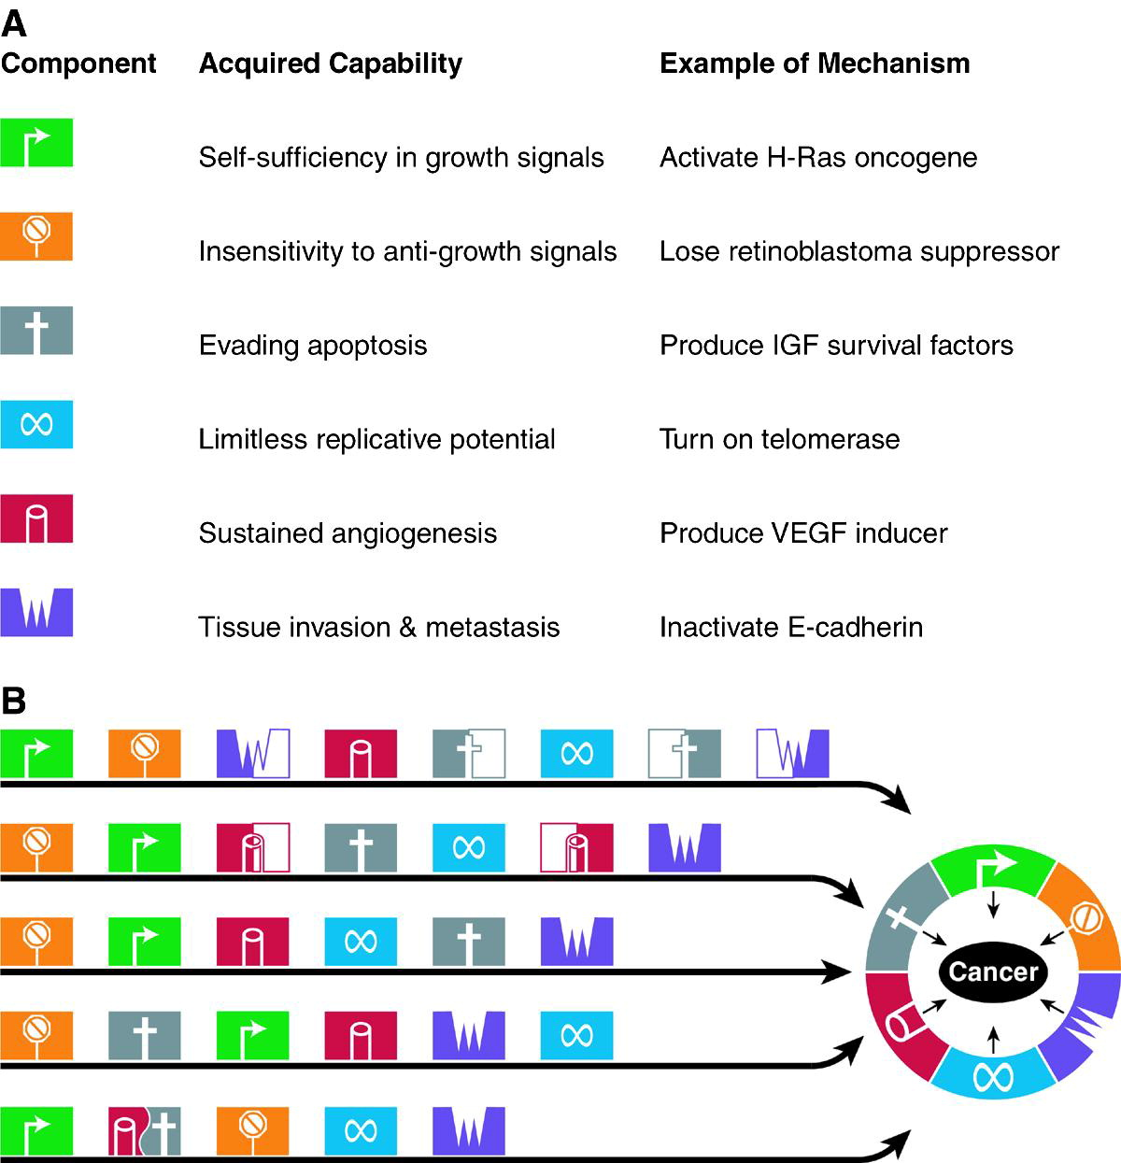
Alternative Pathways to Cancer
Parallel Pathways of Tumorigenesis
While we believe that virtually all cancers must acquire the same six hallmark capabilities (A), their means of doing so will vary significantly, both mechanistically and chronologically (B).
Thus, the order in which these capabilities are acquired seems likely be quite variable across the spectrum of cancer types and subtypes. Moreover, in some tumors, a particular genetic lesion may confer several capabilities simultaneously, decreasing the number of distinct mutational steps required to complete tumorigenesis.
In other tumors, a capability may only be acquired through the collaboration of two or more distinct genetic changes, thereby increasing the total number necessary for completion of tumor progression.

Slide 38
The Hallmarks of Cancer
The Next Generation
2011

Slide 39
The Hallmarks of Cancer
Behind the scenes…
The conception of the paper occurred in 1998 during the USA-Japan Cancer Symposium, in Hawaii.
Hanahan & Weinberg skipped out on some lectures, with a day trip to hike into the dormant volcano Haleakala; During the long day, discussions about cancer while driving from sea level to 3600 meters, a hike down into the crater, then driving down to the shore and back
The idea was to find what are the underlying principles common to all cancer types.
By November 2010, the paper had been referenced over 10,000 times by other research papers, and was downloaded 20,000 times a year between 2004 and 2007.
As of March 2011 it was Cell's most cited article.
On the same month, the sequel paper was published.

Slide 40
March, 2011
On the cover: In their classic Review, Douglas Hanahan and Robert A. Weinberg formulated the six hallmarks of cancer (Hallmarks of Cancer, Cell 100, 57–70, January 7, 2000).
In this issue, Hanahan and Weinberg (pp. 646–674) revisit these original hallmarks in light of the past decade of progress and add four new hallmarks of cancer..
The icons on the cover depict the ten hallmarks of cancer.

Slide 41
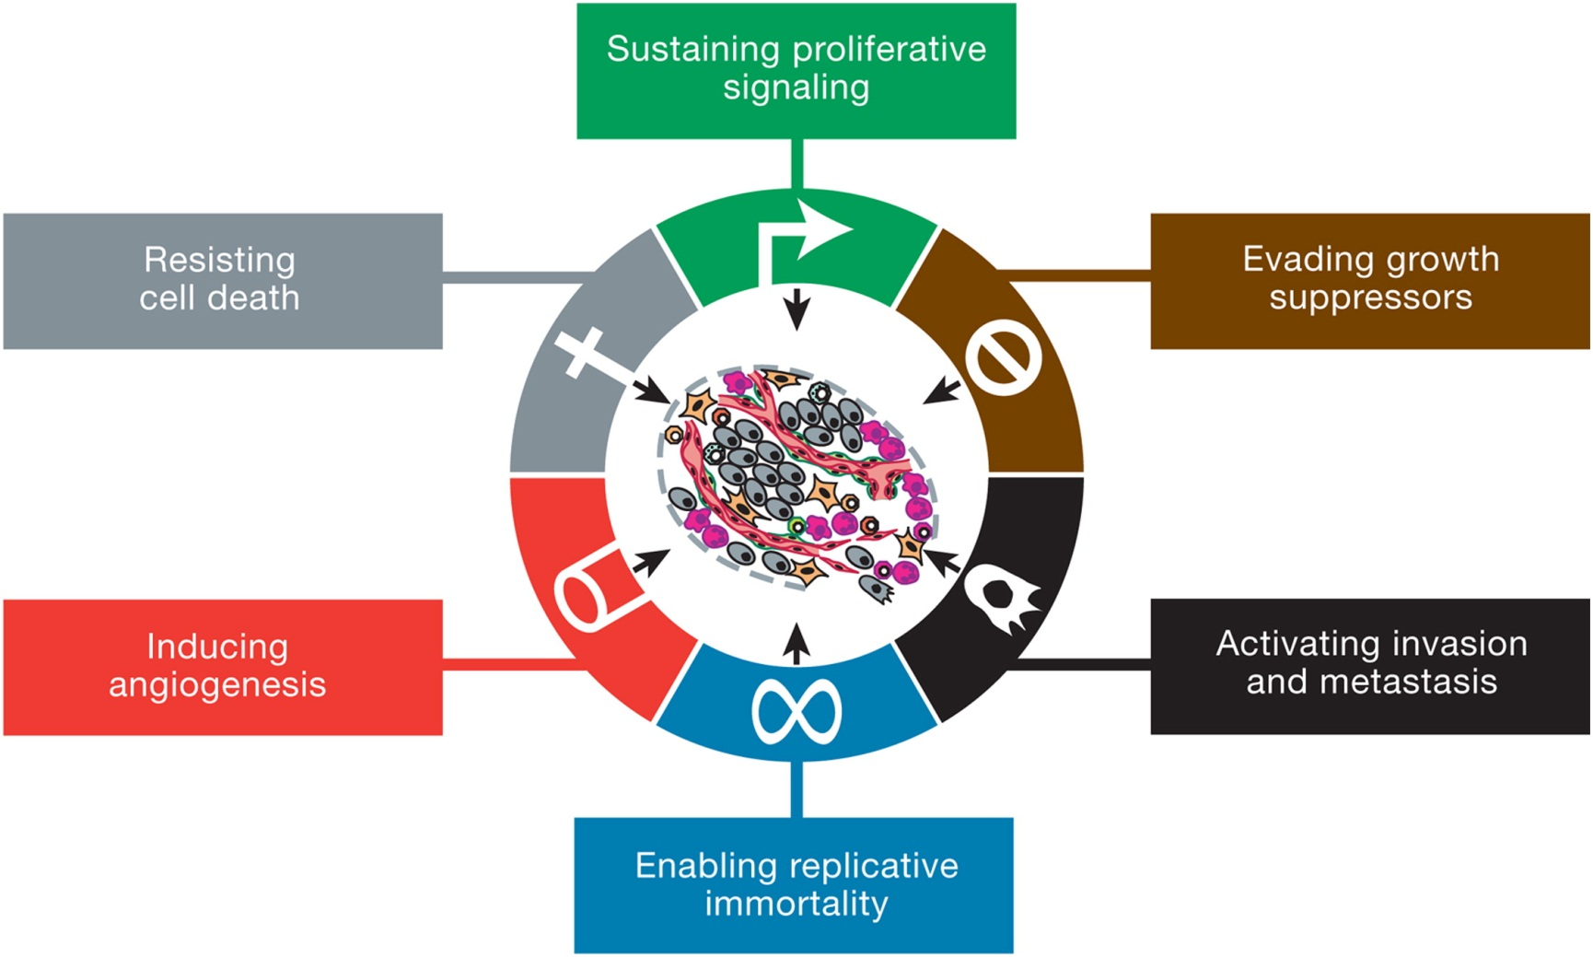
The six original “Hallmarks of Cancer”

Slide 42
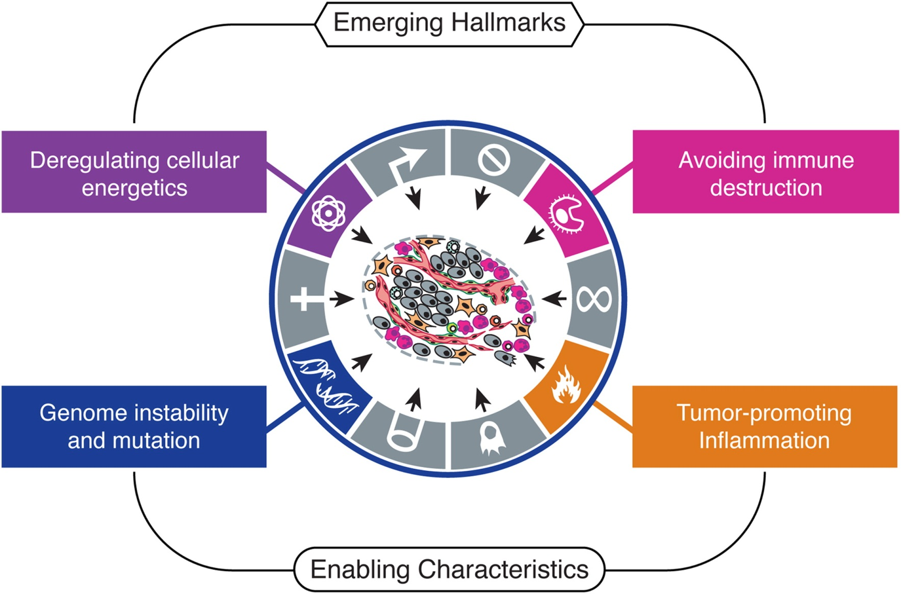
The new paper introduces two emerging hallmarks of cancer, and two enabling characteristics

Slide 43
Emerging Hallmark 7: Reprogramming Energy Metabolism
Cancer cells exhibit not only deregulated control of cell proliferation but also corresponding adjustments of energy metabolism in order to fuel cell growth and division.
Even in the presence of oxygen, cancer cells can limit their energy metabolism largely to glycolysis (which is usually used by normal cells only in anaerobic conditions), leading to a state that has been termed “aerobic glycolysis”.
Though 18-fold inefficient compared with mitochondrial oxidative phosphorylation, generating ATP by glycolysis may allow the diversion of glycolytic intermediates into various biosynthetic pathways, including those generating nucleosides and amino acids required for assembling new cells.

Slide 44
Emerging Hallmark 7: Reprogramming Energy Metabolism
Interestingly, some tumors have been found to contain two subpopulations of cancer cells that differ in their energy-generating pathway: One subpopulation consists of glucose-dependent cells that secrete lactate, whereas cells of the second subpopulation preferentially import and utilize the lactate as their main energy source.
Altered energy metabolism is proving to be as widespread in cancer cells as many of the other cancer-associated traits that have been accepted as hallmarks of cancer, and therefore may be considered as a new hallmark.
On the other hand, it is not necessarily functionally independent from the other core hallmarks, as many of the involved proteins are common.

Slide 45
Emerging Hallmark 8: Evading Immune Destruction
In recent years, an increasing body of evidence suggests that the immune system operates as a significant barrier to tumor formation and progression.
Solid tumor therefore find a way to evade immune destruction.
Possible mechanism: highly immunogenic cancer cell clones are routinely eliminated in immunocompetent hosts—a process that has been referred to as “immunoediting”—leaving behind only weakly immunogenic variants to grow and generate solid tumors.
Immunoevasion is therefore another emerging hallmark, whose generality as a core hallmark capability remains to be firmly established.

Slide 46
Two enabling characteristics
We have so far reviewed the hallmarks of cancer as acquired functional capabilities that allow cancer cells to survive, proliferate, and spread; These functions are acquired in different tumor types via distinct mechanisms and at various times during the course of multistep tumorigenesis.
Their acquisition is made possible by two enabling characteristics:
Genomic Instability
Tumor-Promoting Inflammation

Slide 47
Two enabling characteristics
Enabling Characteristics are not functional capabilities per se, i.e. they are not actions performed by cancer cells and cancerous lesions Rather, Enabling Characteristics facilitate acquisition of the Hallmark capabilities

Slide 48
An Enabling Characteristic #1: Genome Instability and Mutation
Rates of spontaneous mutation in normal cells are usually very low thanks to the extraordinary ability of genome maintenance systems to detect and resolve defects in the DNA.
Mutation rate is often increased in cancer cells through increased sensitivity to mutagenic agents or through a breakdown in components of the genomic maintenance machinery.
In addition, mutation accumulation can be accelerated by compromising the surveillance systems that normally force genetically damaged cells into apoptosis (The role of TP53 is central here).
Defects in genome maintenance and repair are selectively advantageous and therefore beneficial for tumor progression as they accelerate the rate at which evolving premalignant cells can accumulate favorable genotypes.
As such, genome instability is clearly an enabling characteristic.

Slide 49
An Enabling Characteristic #2: Tumor-Promoting Inflammation
It is now clear that virtually every tumor contains immune cells present at varying densities.
Such immune responses are largely thought to reflect an attempt by the immune system to eradicate tumors
However, tumor-associated inflammatory response is shown to have paradoxical effect of enhancing tumorigenesis and progression.
Inflammation can contribute to multiple hallmark capabilities by supplying bioactive molecules to the tumor microenvironment, including:
Growth factors that sustain proliferative signaling
Survival factors that limit cell death
Proangiogenic factors
Extracellular matrix-modifying enzymes that facilitate angiogenesis, invasion, and metastasis.

Slide 50
An Enabling Characteristic #2: Tumor-Promoting Inflammation
Proliferating cancer cells specifically or inadvertently attract the immune system, resulting in subtle or obvious inflammation
Such inflammation includes immune cells specialized in repairing wounds and other tissue damage, whose functions are misdirected to facilitate multiple hallmark capabilities

Slide 51
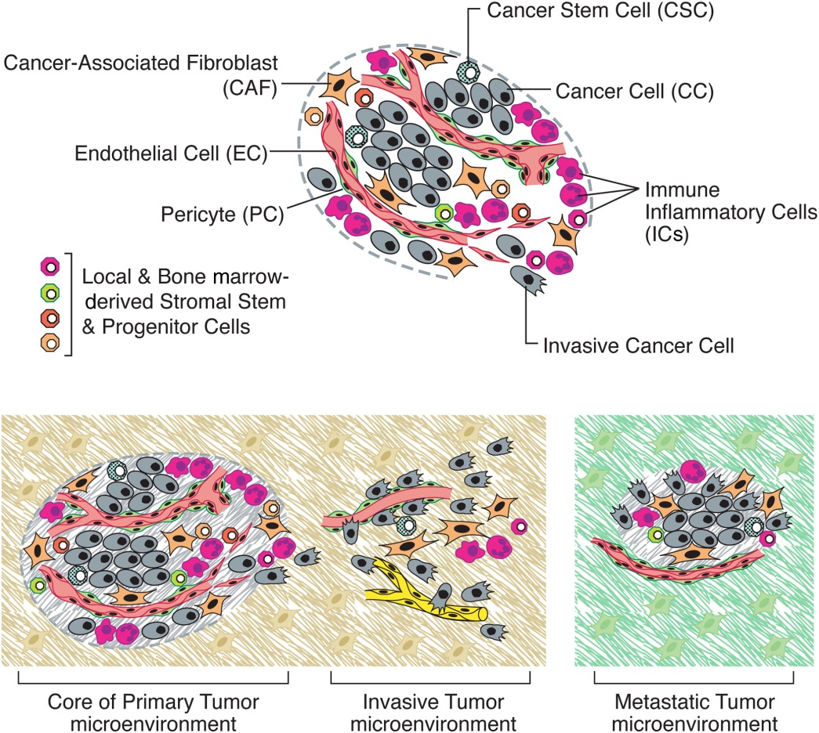
The Tumor Microenvironment
Over the past decade, tumors have increasingly been recognized as organs whose complexity approaches and may even exceed that of normal healthy tissues
Tumors are more than insular masses of proliferating cancer cells. Instead, they are complex tissues composed of multiple distinct cell types that interacts with one another.
Tumors also recruit normal cells, which form tumor-associated stroma, as active participants in tumorigenesis rather than passive bystanders;

Slide 52
The Tumor Microenvironment - CSC
In recent years, evidence has accumulated pointing to the existence of subclass of neoplastic cells within tumors, termed cancer stem cells (CSCs).
They are operationally defined as being able to efficiently seed new tumors upon inoculation into recipient host.
Their source can either be adult stem cells that undergo oncogenic transformation, or differentiated tissue that was de-differentiated due to some genetic change.
Their existence may suggest a different tumorigenesis model.

Slide 53
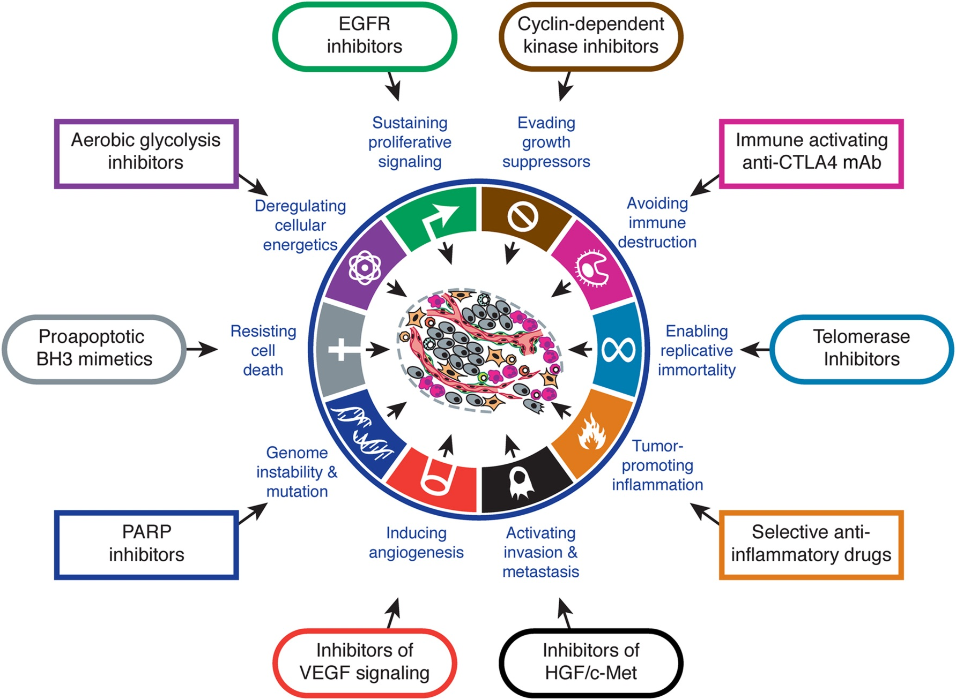
Therapeutic Targeting

Slide 54
Summary
Six acquired cancer hallmarks were introduced:
cancer cells stimulate their own growth;
they resist inhibitory signals that might otherwise stop their growth;
they resist their own programmed cell death (apoptosis);
they stimulate the growth of blood vessels to supply nutrients to tumors (angiogenesis);
they can multiply forever;
they invade local tissue and spread to distant sites (metastasis).

Slide 55
Summary
Two additional emerging hallmarks:
Abnormal metabolic pathways
Evading the immune system
Two enabling cancer hallmarks were introduced:
Chromosome abnormalities and unstable DNA
Inflammation

Slide 56
Summary
Each cancer type can be perceived as a different way to overcome the cellular barriers guarding from cancer.
200 cancer types are conceptually equivalent to 200 different solutions to how to breach the body’s defenses.

Slide 57
Summary – The vision
With holistic clarity of mechanism, cancer prognosis and treatment will become a rational science, unrecognizable by current practitioners.
It will be possible to understand with precision how and why treatment regimens and specific antitumor drugs succeed or fail.
The authors envision anticancer drugs targeted to each of the hallmark capabilities of cancer together with sophisticated technologies that will detect and identify all stages of disease progression.
“One day, we imagine that cancer biology and treatment will become a science with a conceptual structure and logical coherence that rivals that of chemistry or physics”

Slide 58
The End

